Slide 1


Job Search Basics & Interviewing
MSU Denver
Office of Career Services

Slide 2


The Job Search
2 Crucial Skills Required…Persistence & Patience

Slide 3
Know Yourself
What type of job are you looking for?
What skills do you have?
What kind of culture are you seeking?
Do you have geographic preferences?

Slide 4
Know the Job you Want to Do
Job Titles
Skills and abilities required
Salary range
Growth potential
Employment outlook
TOOLS:
O*NET
Bureau of Labor & Statistics
Vault

Slide 5
Prepare your Personal Marketing Materials
Build a resume that targets the job you want
Cover letter & reference page
Professional attire
Professional online presence

Slide 6

Where are most job vacancies found?

Slide 7
Job Vacancy Breakdown

Slide 8
Don’t Forget About…
Career Fairs & Campus Events
Cold Calls (Target Employer List)
MSU Denver JobLink

Slide 9
General Job Search Tips
Be professional
Network – let everyone know you are looking for “X” job
Follow up with employers
Maintain excellent notes – stay organized
Try to remain positive and enthusiastic.
Thank everyone who helps you!

Slide 10

Build your NETWORK

Slide 11
FYI…
Almost everyone HATES networking…
90% of your time should be spent networking.
70% of all jobs are found through networking contacts.

Slide 12

But, I Don’t Have a Network?
Everybody has a network (even if you don’t think you do)
Make a list of people/places that can support your networking strategies.
Workshops, seminars & conferences
Career fairs
Student clubs and professional associations
Community gatherings, social events, & family gatherings
School and alumni events
Make every interaction count
30-second elevator pitch

Slide 13
Building Your Elevator Pitch
Elevator pitch answers the question:
“What can you tell me about yourself?”
What you have done
What you want to do &
The major skills you have to do it

Slide 14
Sample Elevator Pitch
“Hi, my name is Mary. I received my bachelor’s degree in Human Services in 2017.
I completed 2 internships, one in crisis intervention and one as a co-facilitator for groups in a correction facility.
I am really excited about breaking into the counseling field, specifically with a focus on adults with disabilities.
I actually financed my college education by working as a residential counselor for disabled adults.”

Slide 15

Using Social Media to Network
TIPS:
Establish new contacts strategically; connect with people with common career interests
Seek LinkedIn recommendations and endorsements from people who know you well
Join LinkedIn groups that reflect your professional interests
Comment thoughtfully on professional pages and discussions

Slide 16
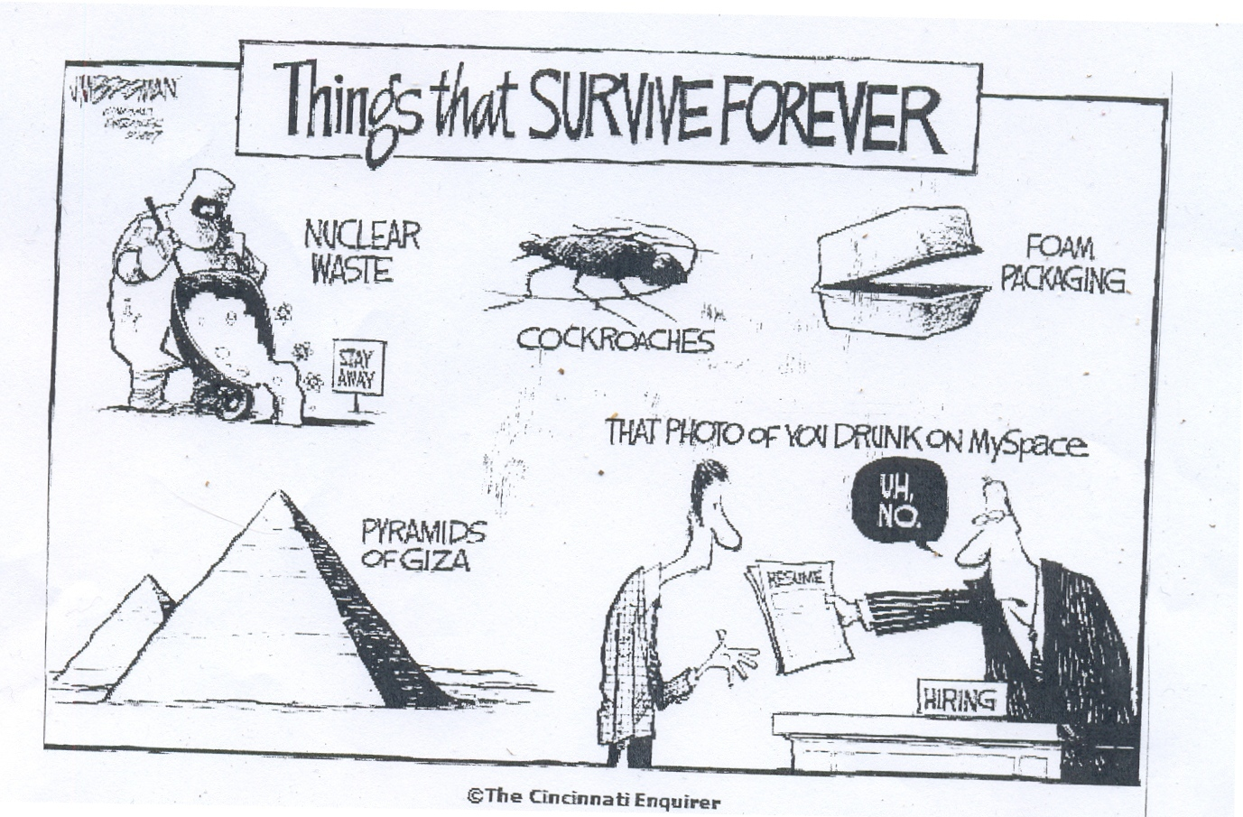
Clean up you Social Media Accounts

Slide 17

You’ve Scored an INTERVIEW…Now What?

Slide 18
General Interview Prep:
Know why you want the job.
Review the job description
Research the organization
Prepare copies of your resume and references
Relax!

Slide 19
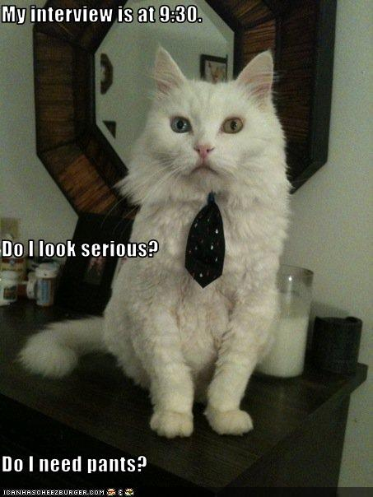
Dress Appropriately

Slide 20

Make a Solid First Impression
Be courteous and smile
Make eye contact
Shake hands firmly, but don’t crush bones.

Slide 21
Types of Interview Questions
Open-ended: “Tell me about yourself.”
Specific: “Why did you choose your major?”
Behavioral-based: “Tell me about a time when...”
Illegal: “What country are you from?”

Slide 22

Answering Interview Questions
General Tips:
Tell the truth but don’t over-share
Pay attention to non-verbal cues
Be confident
Be professional and positive at all times

Slide 23
Practice, Practice, Practice!
Practice with friends/family, or with Career Services in a mock interview
Review common interview questions
Have appropriate stories to tell for behavioral based questions.

Slide 24

Use the S.T.A.R. Technique

Slide 25
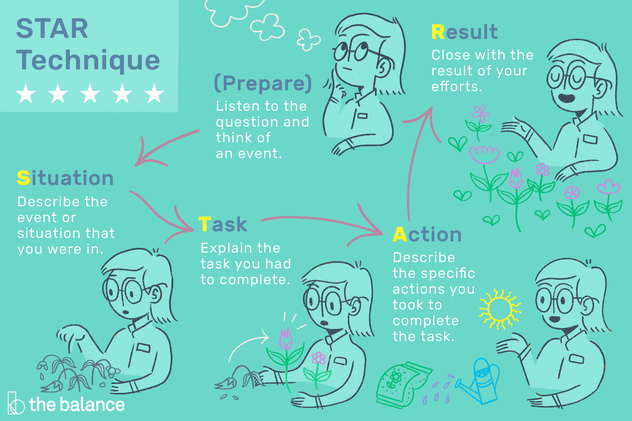

Slide 26
Common Questions
Always Prepare for these Questions
“Tell me about yourself.”
“Why are you the best candidate for the position?”
“What are your greatest strengths & weaknesses?”
“Where do you see yourself in 5 years?”

Slide 27
Always have Questions for the Employer
Remember you are interviewing the employer for fit as much as they are interviewing you.
Your questions should demonstrate interest and be informed.
Should NEVER be about salary or benefits in the first interview

Slide 28

Interview Follow up
Send a thank you letter or email right after the interview.

Slide 29
Questions?
Tennille Hamler, MA
Career Specialist – STEM Majors
toverman@msudenver.edu
303-615-1021
Office of Career Services
AD 270
www.msudenver.edu/career
303-615-1133
Thank you!

